Slide 1
Data Analytics
Darshan Thota
Madigan Clinical Informatics Fellow
NOV2018
Notes:
Hey guys, I’m going to talk to you today about Data Analytics

Slide 2
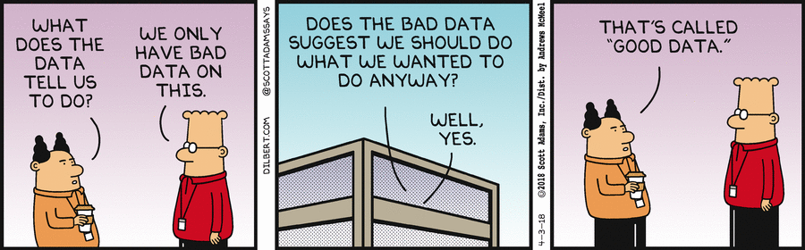

Slide 3
Briefing Overview Slide
Briefing Type- informational
Briefing Overview (BLUF)- data analytics are a fundamental tool for deliver of safe, efficient, effective health care
Issue / Topic Routing Recommendation- None
Decision(s) Required-No decision required at this time
Notes:
This is the breifing overview slide. This is an informational brief. No decision is required and we’ll take about why data analytics is important.

Slide 4
Objectives
Define Data Analytics
Understand the 3 Levels of Data Analytics
Exposure to Data Mining Techniques
Data Analytics Workforce
Use case Examples
Discussion questions
Take Homes
Notes:
Here are objects. Fist we’ll define data anatlyics and then look at the 3 levels of analtyics. Then we’ll look at differentt Data Mining Techniques as well as get a glimpse into the Analtycis Workforce. Finally we’ll wrap use with some use cases and take homes.

Slide 5
Definition
“ The systematic use of data and related business insights developed through applied analytical disciplines (e.g. statistical, contextual, quantitative, predictive, cognitive, other including emerging models) to drive fact-based decision making for planning, management, measurement and learning (IBM 2012)”
Notes:
Here’s a definition of data analytics from the Hoyt review book. As you can see it’s a bit wordy and cerebral. Wha
Hoyt R. Health Informatics: Practical Guide for Healthcare and Information Technology Professionals (Sixth Edition) 6th Edition. Lulu. 2014
t does this really mean?

Slide 6
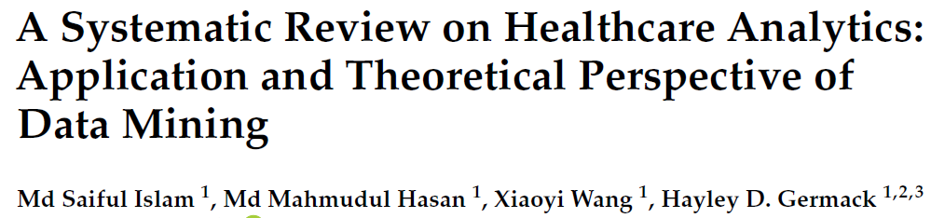
Why do we care about data analytics?
“Use of analytics—including data mining, text mining, and big data analytics—is assisting healthcare professionals in disease prediction, diagnosis, and treatment, resulting in an improvement in service quality and reduction in cost (Saiful) ”
Notes:
I like this definition by saiful much better. Its small and much clearer and explain why we should care about data analytics! Data analytics are important because it allows us to predict, find trends, and optimize treatment of patients. Saiful I. A Systematic Review on Healthcare Analytics: Application and Theoretical Perspective of Data Mining. Healthcare (Basel). 2018 Jun; 6(2): 54.

Slide 7
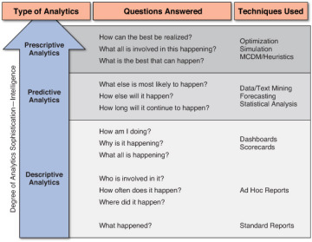

Levels of Analytics
Notes:
Delen D. Real-World Data Mining: Introduction to Analytics. Pearson FT Press. 2014
Descriptive- lowest level, easiest to get , Ex. Door to Doc, Doc to Disp. This tells you what happened. This isn’t helpful in telling you trends, or what to do.
Predicative- You find patterns here. This looks for trends and outcomes. is where we spend a lot of time and energy right now. Ex. CDS. What is the risk of bounceback by the CURB 65 if I d/c this pt. w/ PNA?
Prescriptive This is where we want o tbe with Machine Learning and AI. Ex. What med do I need to give for CHF/CPOD EBM optimized outcomes?
Descriptive = what happened?
Predictive- What else will happen? Prescriptive- How can we achieve the best outcomes

Slide 8
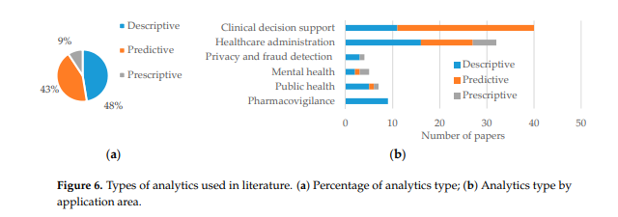
Which type is used most often?
Notes:
This comes from the Saiful article from before. It shows what you think it would. Right now we are much better at Descriptive Analtyics that we are at predictive or perscriptive. CDS is the number one application from both descriptive and prescriptive. Admin, finance, ROI is number 2. Interestingly, privacy and fraud detection is number three, I never really thought about using analyics for this purpose but I suppose that makes sense.
“A Systematic Review on Healthcare Analytics: Application and Theoretical Perspective of Data Mining “
Md Saiful Islam 1 , Md Mahmudul Hasan 1 , Xiaoyi Wang 1 , Hayley D. Germack 1,2,3 and Md Noor-E-Alam

Slide 9
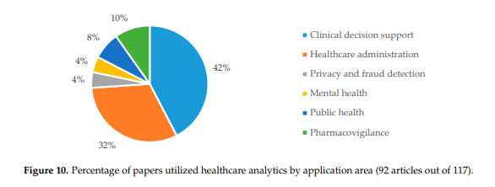
Where are analytics used most?
Notes:
This is showing the same data in a different pie graph representation and you can see here again that CDS is the number one category of use for analytics.
“A Systematic Review on Healthcare Analytics: Application and Theoretical Perspective of Data Mining “
Md Saiful Islam 1 , Md Mahmudul Hasan 1 , Xiaoyi Wang 1 , Hayley D. Germack 1,2,3 and Md Noor-E-Alam

Slide 10
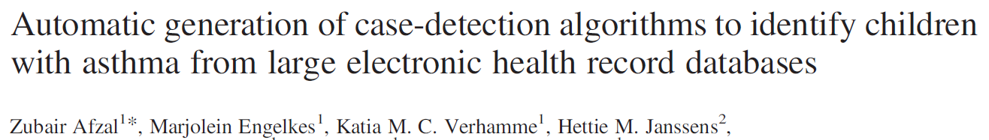
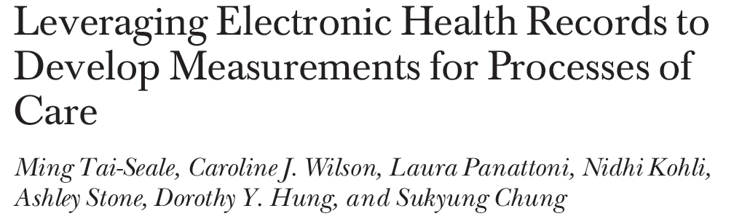
Descriptive Analytics Examples
Notes:
This first study was done in 2013. They used a machine learning algorthim called RIPPER to look for definate or possible ashtma in a peds pating set from ages 5-18. 5034 records were assessed using machine learning algorhthms based on free text unstrucuted data and structured ICD 9 codes. The Ripper program had 98%sensitivity and 95 specificity for finding cases of definite asthma with a PPV of 66%. It didn’t perform as well for possible or doutful asthma
The second study looked at measuring the process of care at 4 hospitals in California 15, 370 w/ DM2 and 49, 561 patients with HTN were studied. A1C, LDL, and BP were measured along with number of emessages and number of days until follow up after e message. They found that the more number of e messges correlated with better A1c and LDL control while the closeness of next day f/u correlated with better BP control
Afzal Z. Automatic generation of case-detection algorithms to identify children with asthma from large electronic health record databases. Pharmacoepidemiology and drug safety. 2013; 22: 826–833
FitzHenry F. Exploring the Frontier of Electronic Health Record. Med Care. 2013 Jun; 51(6): 509–516.
Tai-Seale, M. Leveraging Electronic Health Records to Develop Measurements for Processes of Care. Health Service Reseach. Health Serv Res. 2014 Apr; 49(2): 628–644

Slide 11
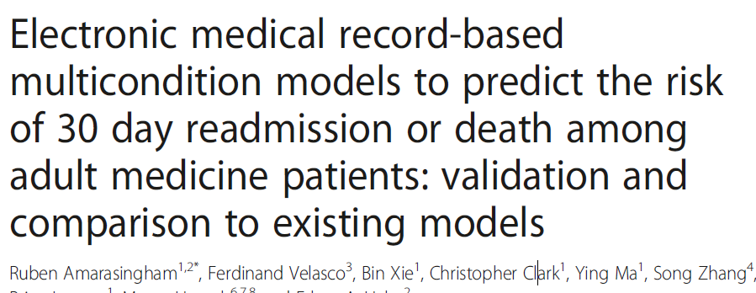
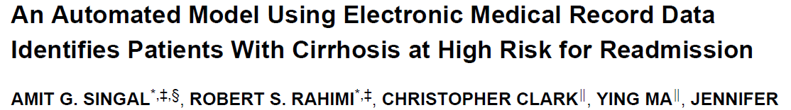
Predictive Analytics Examples
Notes:
This first study used the EMR to try to predict death or bounceback 30 days after discharge for CHF. This study looked at 7 hospitals in Dallas in 2010. This model was compared against CMS and Canada’s reimbursement prediction models. They looked at vitals, cbc, chem, LFT’s, and previous admits as components of the model and found that theirs compared better than CMS and Canada for the 39,604 patients looked at.
This second study looked at prediction risk factors using at 30 day model for risk of readmisstion for cirhotics. 836 cirrhotic patient that got readmitted in 2008-2009. This team found that PLT, AST, # readmits, Medicaid, # address changes and MELD were good predictors of 30 day bounceback. They used the C-statistic which is the ROC area under the curve and found that their C statistic was 0.68 and 0.66 in their initial and validation cohorts. 0.5 is bad and 0.7 is good.
Amarasingham R. Electronic medical record-based multicondition models to predict the risk of 30 day readmission or death among adult medicine patients validation and comparison to existing models. BMC Med Inform Decis Mak. 2015; 15: 39.
Singal A. An Automated Model Using Electronic Medical Record Data Identifies Patients With Cirrhosis at High Risk for Readmission. Clin Gastroenterol Hepatol. 2013 October ; 11(10):
Alvarez C. Predicting out of intensive care unit cardiopulmonary arrest or death using electronic medical record data. BMC Medical Informatics and Decision Making 2013, 13:28

Slide 12
More Definitions
Data science- the field of learning how to manipulate data
Machine Learning- new area of computer science that looks at systems and algorithms that can learn from data Ex. AI
Data Mining- discovering new patterns from the processing and modeling of data Ex. Amazon, Netflix, Target, Pandora
Text mining- type of data mining that looks at free text. Ex. NLP, Google Gmail, Yahoo mail
Personalized medicine- Genomics data
Precision medicine- making treatment more precise
Big Data
Notes:
Ok here are some more definitions that are related to the field of data analytics.
Machine learning– Area Of Computer Science Focused On Systems And Algorithms That Learn From Data (Flach, 2012; Crown, 2015)
Data Mining – Processing And Modeling Of Data To Discover Previously Unknown Paberns Or Rela1onships (Bellazzi, 2008; Zaki, 2014)
Text mining– Applying Data Mining To Unstructured Textual Data (Aggarwal, 2012)
You’ve heard of Big Data before. That’s the new all encompassing term to describe the four charactersitcs of big data

Slide 13
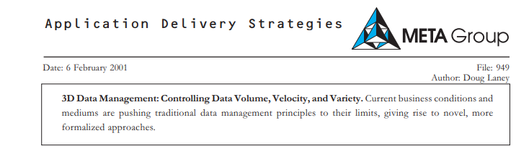
Big Data
How Much- Volume
How Fast – Velocity
How Many- Variety
How true- Veracity
Notes:
Which are volume, velocity, variey, and veracity. Essentially, how much data is available, how fast that data comes, the types of data being generated and how accurate and reliabile data is.
This article from 2001 is allegedly where this idea first arised according to this article
http://www.pdhealth.mil/news/blog/intro-data-using-big-data-military-health-system

Slide 14
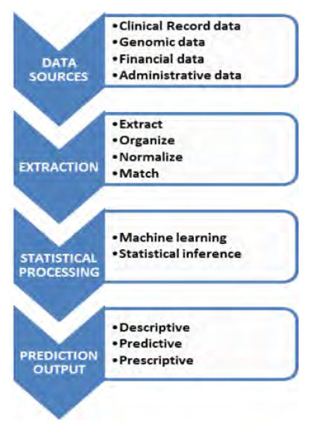
The Data Analytics Pipeline
Notes:
This is the overviw of the Data Analtyics pipeline. Were’s going to go over all of these in detail. First is knowing where the data is coming from, this is your patient data, monitor data, biosensor data, claims data or FB data.
This picture shows the flow of data from point of origin to extraction, analysis, and productive output.
Adapted from Kumar et al)
Kumar A. Hazy: making it easier to build and maintain big-data analytics. Communications of the ACM, 2013. 56(3): 40-49.

Slide 15
Data Sources
Internet and Social Media- Facebook, Twitter, LinkedIn
Sensor data- Readings from medical devices(pulse ox)
Biometric data- Finger prints, retinal scans, blood pressure
Big transection data- Healthcare bills, insurance claims
Human generated data- Prescriptions, EHR, emails
Notes:
Here are those data sources that I was Mentioning earlier. Biosensor like fitbit, smart shirts, finaical data, Big data like emails.
“A Systematic Review on Healthcare Analytics: Application and Theoretical Perspective of Data Mining “
Md Saiful Islam 1 , Md Mahmudul Hasan 1 , Xiaoyi Wang 1 , Hayley D. Germack 1,2,3 and Md Noor-E-Alam

Slide 16
Data Mining Extraction techniques
Regression- Relationship proximity between variables
Association- Finding relation between variables
Clustering- Identification of groups and categories in data
Anomaly- detection of out-of-pattern events or incidents
Data warehousing- A large storage of data to facilitate decision-making
Sequential pattern- mining Identification of statistically significant patterns in a sequence of data
Notes:
Step 2 in the Data Analtyics pipeline is Data Mining. These are all statistical tools to be able to pull, clean and interpret the data. Regression is the fitted line on the excel file, regression to the mean which looks for relationship proximity between variables . It’s closed tied to association which looks also looks for relations between variable's Anomaly are data points outside the norm. Data warehousing examples are a CDR or data repository. Clustering means looking for groups or categories within the data.
“A Systematic Review on Healthcare Analytics: Application and Theoretical Perspective of Data Mining “
Md Saiful Islam 1 , Md Mahmudul Hasan 1 , Xiaoyi Wang 1 , Hayley D. Germack 1,2,3 and Md Noor-E-Alam
Data mining techniques applied to extract and communicate information from the dataset

Slide 17
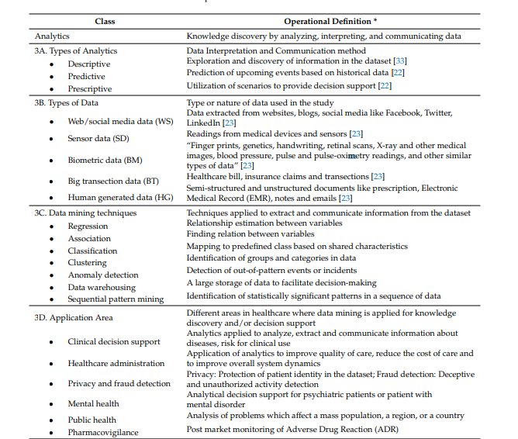
Notes:
This comes from the Saiful article that we saw earlier. This is a busy chart but is show detailed examples of the data analytics pipeline. Here is step one with data sources, step two with Data extraction and step 3 with Statistical processing.
“A Systematic Review on Healthcare Analytics: Application and Theoretical Perspective of Data Mining “
Md Saiful Islam 1 , Md Mahmudul Hasan 1 , Xiaoyi Wang 1 , Hayley D. Germack 1,2,3 and Md Noor-E-Alam

Slide 18
What can you do with the data?
Clinical decision support
Public health surveillance
ADR surveillance
Healthcare billing
Privacy and fraud detection
Notes:
The third step is the statistical processing and this is where the rubber meets the road. Specific examples of what you can do with the data are CDS for medical patient and mental health patintes, disease surveilance and point investigation outbreak, adverse drug monitoring and alterts and bliing.
“A Systematic Review on Healthcare Analytics: Application and Theoretical Perspective of Data Mining “
Md Saiful Islam 1 , Md Mahmudul Hasan 1 , Xiaoyi Wang 1 , Hayley D. Germack 1,2,3 and Md Noor-E-Alam
Application Area Different areas in healthcare where data mining is applied for knowledge discovery and/or decision support. This last one is interesting, if you guys read freaknomincs or Superfreaknonicms, the guys in thtat boook talk about using metrics and trends in data to identify how to catch a terrorist using demographics and shopping information. Yeah, ceratin men of a ceratin age are likely to shop on certain days for particular items, cross checking this group with a background check helped the FBI locate a terrorist according to their book.
Clinical decision support Analytics applied to analyze, extract and communicate information about diseases, risk for clinical use
Healthcare administration Application of analytics to improve quality of care, reduce the cost of care and to improve overall system dynamics
Privacy and fraud detection Privacy: Protection of patient identity in the dataset; Fraud detection: Deceptive and unauthorized activity detection
Mental health Analytical decision support for psychiatric patients or patient with mental disorder
Public health Analysis of problems which affect a mass population, a region, or a country
Pharmacovigilance Post market monitoring of Adverse Drug Reaction (ADR

Slide 19
Nonclinical uses of Analytics
Baseball “Moneyball”
Netflix/Amazon
Twitter used to predict stock market
Facebook demographics- age, race, sexual orientation
NSA- email/phone call tracking
Notes:
If you guys saw Moneyball, then using Game theory, the main character was able to look at metris rather than gut feel in order to come up with his success alogrphym for picking basball players.
In Dave Masuda’s class last week there was an article about the amount of information that Amazon collects on you was staggering. There was a murder in 2016 where the bad guy used Amazon Echo information to kill a lady.
FB collects demographic data all the time for financial analysis and marketing
The NSA uses analaytics for population surveliance
Twitter is used to monitor pulbic opinon for psychologic decision making about the stock market

Slide 20
Stakeholders
Civilian Side- CFO (bottom line, ROI), CMO (outcomes), IT personnel(job security)
DHA- SECDEV, Joint Chiefs, Combatant Commanders, Surgeon General, warfighter and dependents
Notes:
Who other than us cares about analytics? The stakeholders are all the big picture people who care about data.
Who are the stakeholders in the civilain and military populations? In civialn world, stakeholders are the CEO, CFO, and CMIO
The correlarly in the military population is our SECDEE, Joint Chiefs, Commbant Commabners, warfighres and depedatns

Slide 21
How is analytics relevant to health civilian care?
CHF Bounce-back prediction
Asthma prevention
CMS reimbursement
HIE and Data access
Billing of medical records
Research- Predicating new diagnoses in patients
Notes:
We looked at some examples earlier of studies that used descriptive and predictive analaytics, other things that CMS looks at are quality metrics like Astham prevetnion, CHF bounceback, HIE and access, b illing
Research reports
Metric quality measures and performance based care
NLP for CDS
RVU reimbursement
Since payment models are moving from Fee for service to value based case, data analytics will be needed for reporting tools on metrics (CHF/COPD bounceback, ED utilization, wait times, etc..)
Quality metrics will rely on Data analytic models which will directly effect CMS reimbursement
Data acess is critical component for data analytics and HIE can help with this
Administrative data is used for billing of medical recores
Research- Ex. Using ICD 10 codes to see the number/types of chief complaints urgent care/ED sees and provide teaching/training to docs/nurses corspman on UTI protocols, sore throat protocols, and STEMI/CVA tx.
CHF Bouncebakc reimbursement
Asthams prevetnion
CAD, DM2 preservation w/ stations
Reimbursement
Validating RCT’s tsing CDR
NLP for prescreptive CDR monitoring of patients (VA does this)
Prediciting new diagnoses in patients

Slide 22
How is analytics relevant to military care?
Readiness report for combatant commanders
Manpower specific needs- Ex. languages
Equipment tracking- Location and lifecycle
Notes:
Analytics can be used to srub the Binanacle list for people on LIMDU/Profile or who are out for DNBI. NLP can be used to find someone with a certain skill like a translator. Equipment lifestyle and tracking can also be used with analtyics surveilaince programs.
White paper 2013
https://defensesystems.com/articles/2018/06/19/comment-dod-analytics.aspx
“cutting-edge data analytics, which provide greater visibility of everything from skill specialties of personnel to equipment inventory. Arming senior leaders with these tools gives them access to a myriad of critical data points within seconds, enabling them to make informed decisions about the mission-preparedness of our military troops.”
If there is a mission that requires a soldier who speaks Farsi, data analytics can help military leaders seamlessly narrow down the available options in their talent search by only displaying soldiers who can speak the language.
Data analytics can provide military leaders with the intelligence needed to quickly uncover the current operational status and location of equipment. Defense leaders can easily leverage accurate data to make decisions if a tank needs to be transported from one military base to another, or if a helicopter needs to undergo necessary maintenance updates. Without the technology needed to effectively track a machine’s readiness status, it greatly hinders training and defense operations.

Slide 23
Skills needed in analytics?
Data and Computer Science background
Programming in SQL, Oracle
Statistical and Bayesian analysis
Data interpretation/representation
Modeling
Communication
Keith
Notes:
What is needed to work in the field of analytics? Data science, programming in SQL, computer seicne, an understanding of Bayseian analaying, understanding data extraction and interperationat techquie, mathemetcal moedling and problably most important is communication. It’s like that scene in office space, I take the files to the Engineers.. What would you say you do here?
Keiths’s a good example of who we have on staff that encompasses all of setense

Slide 24
ED Wait Times Use Case
1. How can we use descriptive analytics to measure choke points in Input and throughput?
2. By looking at where the choke points are you can start to determine where you need to put your time and effort and research. You need to look at triage, vitals, labs/rads, medic/nursing assessment, transport time to the bed, transport time to xray, CT time, MRI time, d/c time, cleaning the bed time
3. How can we use predictive analytics to find what equipment or staffing is needed to fix the problem?
4. Now that you have a question you can look at data and build a model to see if its cheaper to buy another CT or MRI or another nurse
Notes:
Ok, so I wanted to go over a couple of use cases both for the hospital and operational settings. Lets say that you are interested in looking at ED wait times. You first want to figure out where your choke points are. It might be at triage, or the medic taking vitals, or a delay getting to/from rads, or transport times on/off the floor. Metrics can help you specifically identify what process problem you have.
Then the next step is having Keith to create a model to generate potentials solutions like starffing more nurses or getting a new scanner. Will the initial cost of these fixes really help in the long run to fix the problem and is it cost effective to do so.
agnosis is 50% of the problem
Analytics is a large field with a lot of silos, or bins.
Each of the list you can spend a year on
I want to give you a brief overview and a Use Case in order to have a take home that you can use yourself or for other people in order to teach them how to maximize data analytics statisticianss
High cost patients- looking for ways to intervene early to reduce cost and improve health
Preventing readamidssions
Triage- sending people to the right level of care
Decompensation- predicting and interventing when pt. do worse
Preventing and Identifying AE
What is the optimal treatment for a patient for multiple disesaes

Slide 25
Okinawa Use Case
Helicopter crash in Okinawa with 6 patients
1 host nation, 1 walking wounded, 1 closed tib/fib, 1 femur frx, 1 Epi/subdural requiring crainiotomy, 1 nuerogenic shock
How can we use descriptive models to decrease transport time from the helipad to the ED and then to the OR
How can we use predictive models to help with adequate staffing during mass cals?
Notes:
Ok, so this actually happened to me. It was my 6th day on Okinawa and I literally got done with new patient orientation and then I got a call saying that a helo with some of the SF guys crashed. I didn’t have a car so I walked up to the hospital and there were 6 patients. 1 host nation, 1 guy wasn’t hurt, one crani, 1 nuerogenic shock, one close tib fib, one open femure frx
One issue that came up was delay in getting patients from the helo pad to the ED and then delay in getting them to the OR.
Using are actualy data, a model could be used to look a predictive factors that might help decrease transport time. Staffing is one consideration, do we need to implement more nurses and corpsman to help with transport durign mass calls

Slide 26
Challenges
Inaccurate data- not a top priority for docs (de Lusignan, 2005)
Incomplete data- patients get care at different places (Bourgeois, 2010; Finnell, 2011).
Lack of interoperability (Kellermann, 2013)- FHIR solution?
“Locked” text data- NLP solutions?
Is data detailed enough?
Too much data
Who owns the data?
Notes:
Data veracity and accuracy is an issue. Dr. Marshall has mentioned that people do what is easy not what is best when you’re busy in clinic.
A lack of HIE between us and the civilian side makes records incomplete
Interoperatbility is also an issue but our FHIR conference makes this a promising solutioant that we may see in our lifeitems
Sometimes data is so granular that its hard to make sense of
Also, sometimes there is too much data to sift though making processing times long
Owndership is also an issue. Tradionally, docs have owned EHR data but now that patient’s have open access to portals, is this going to change moving forward? We’re in a patient ccentering time where autonomy is the key driver in the healhtcare system so that’s very possibly what might happen going forward

Slide 27
Discussion questions
What predictive analytics models would help with integration and optimization of EHR implementation?
Are data analytics models effectively used for measuring finance and reimbursement?
Where can prescriptive analytics be used in pre and clinical settings to improve outcomes measures in military populations?
Where can we use analytic models in the forward deployed battlespace to improve clinical outcomes?
Notes:
So what modesl might help with EHR implemetiona?
In our system, do we have a good way of meaursing ROI or EHR value?
Prior to deployment, can screening algorphy be developed to prevent medical decompensation prior to deployment?
In what ways can we use analytics in improve care in the battlespace?

Slide 28
Key take home
Levels of analytics
Key is knowing what question you want answered and defining Specific parameters
Combination of good question with data tools yields a powerful ability to glean data
Notes:
Here’s what I want you to be able to take home. There are 3 levels of analytics. Descriptive, Predictive, and persprective. As time moves on and as things get better there will be a shfit from predictive where we are currently at to prescribpitive
This is a key takeaway from Keith. A doc that knows atha question he wants answered combined with a data analyttis that can pull that info is a very powerful tool but the key is knowing what question you want to ask.

Slide 29
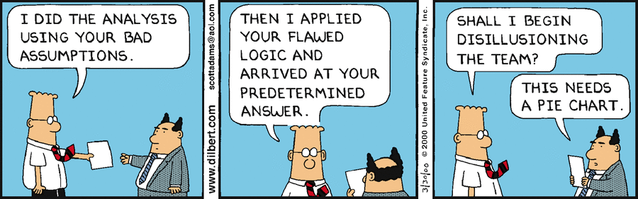
Notes:
This was from Keith

Slide 30
References
Hoyt R. Health Informatics: Practical Guide for Healthcare and Information Technology Professionals (Sixth Edition) 6th Edition. Lulu. 2014
Saiful I. A Systematic Review on Healthcare Analytics: Application and Theoretical Perspective of Data Mining. Healthcare (Basel). 2018 Jun; 6(2): 54.
Delen D. Real-World Data Mining: Introduction to Analytics. Pearson FT Press. 2014
Afzal Z. Automatic generation of case-detection algorithms to identify children with asthma from large electronic health record databases. Pharmacoepidemiology and drug safety. 2013; 22: 826–833
FitzHenry F. Exploring the Frontier of Electronic Health Record. Med Care. 2013 Jun; 51(6): 509–516.
Tai-Seale, M. Leveraging Electronic Health Records to Develop Measurements for Processes of Care. Health Service Reseach. Health Serv Res. 2014 Apr; 49(2): 628–644
Amarasingham R. Electronic medical record-based multicondition models to predict the risk of 30 day readmission or death among adult medicine patients validation and comparison to existing models. BMC Med Inform Decis Mak. 2015; 15: 39
Singal A. An Automated Model Using Electronic Medical Record Data Identifies Patients With Cirrhosis at High Risk for Readmission. Clin Gastroenterol Hepatol. 2013 October ; 11(10)
Alvarez C. Predicting out of intensive care unit cardiopulmonary arrest or death using electronic medical record data. BMC Medical Informatics and Decision Making 2013, 13:28
Kumar A. Hazy: making it easier to build and maintain big-data analytics. Communications of the ACM, 2013. 56(3): 40-49.

